Slide 1
State University of New York
Health Science Center at Syracuse

Slide 2
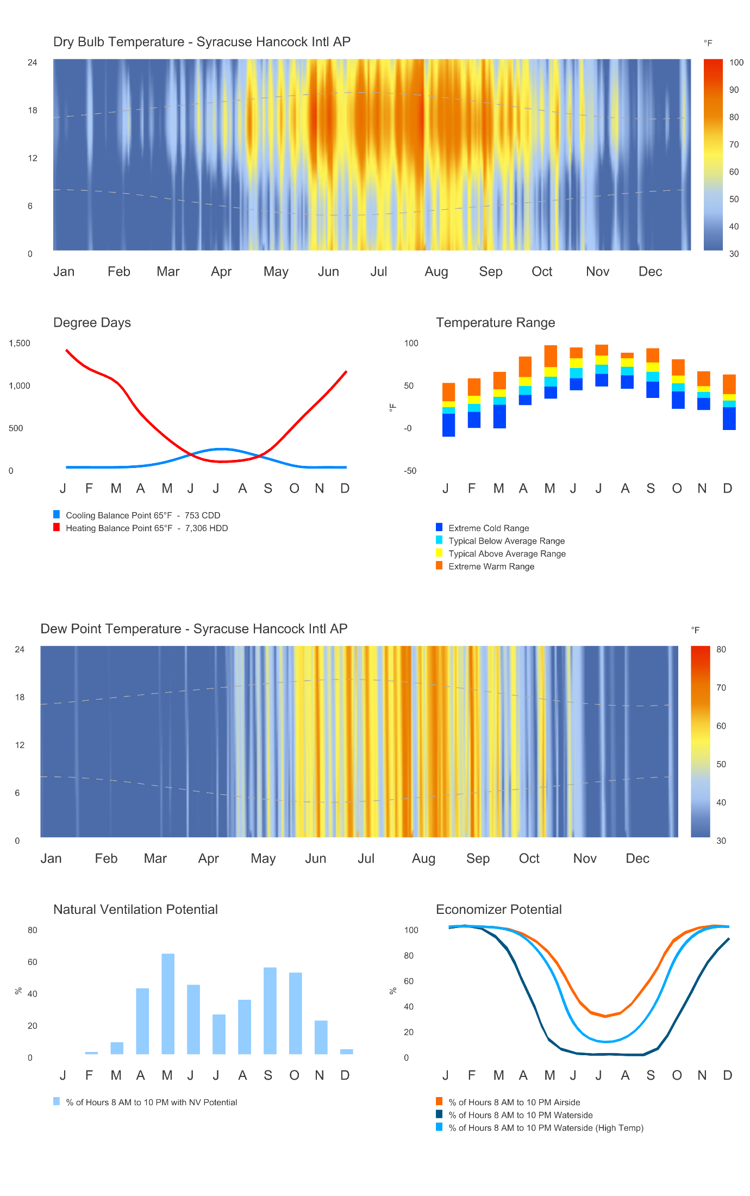
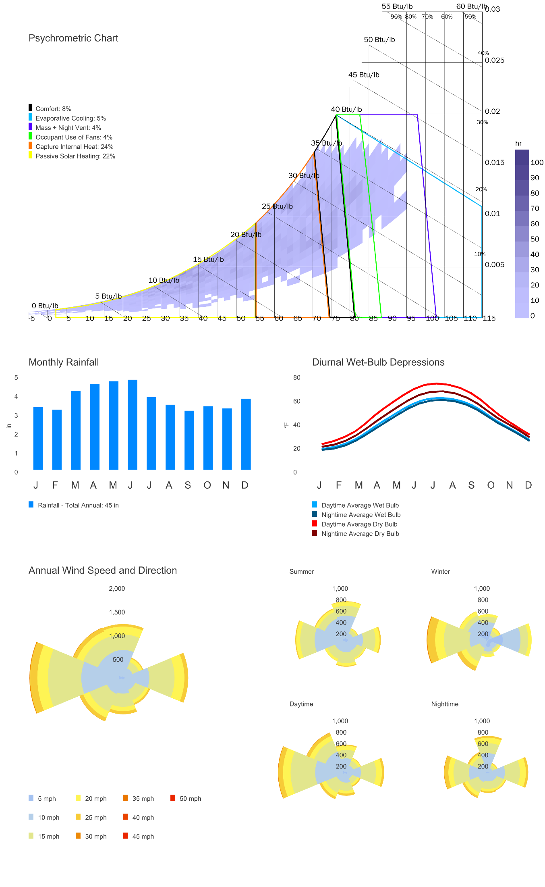
Climate Analysis
YEAR 2025
Climate Zone 6A
Temperature + Humidity
Defined by cold, harsh winters with temperatures regularly falling well below freezing, and moderate to warm summers accompanied by elevated humidity levels. Balance needed between minimizing winter heat loss and avoiding summer overheating.
Decent potential for NV during shoulder seasons
Higher insulation requirements. Air sealing is critical to prevent heat loss and moisture infiltration
Rainfall
Consistent rainfall throughout the year, potential for rainwater collection to offset building water use.
Wind
Predominantly from the west and southwest throughout the year. High wind speeds at street level impact pedestrian comfort and entrance design.

Slide 3
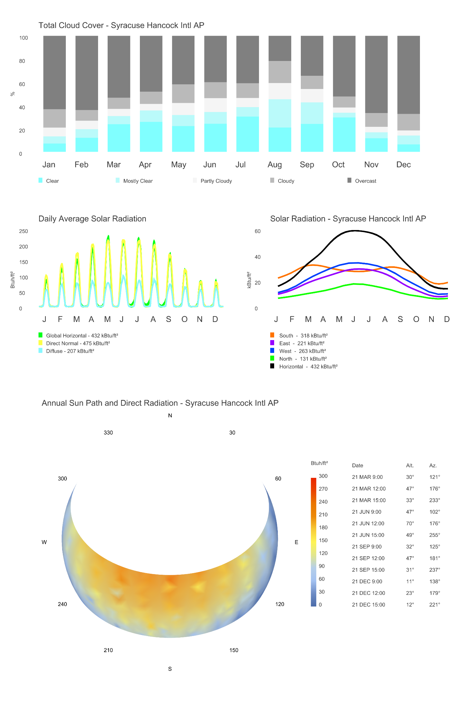
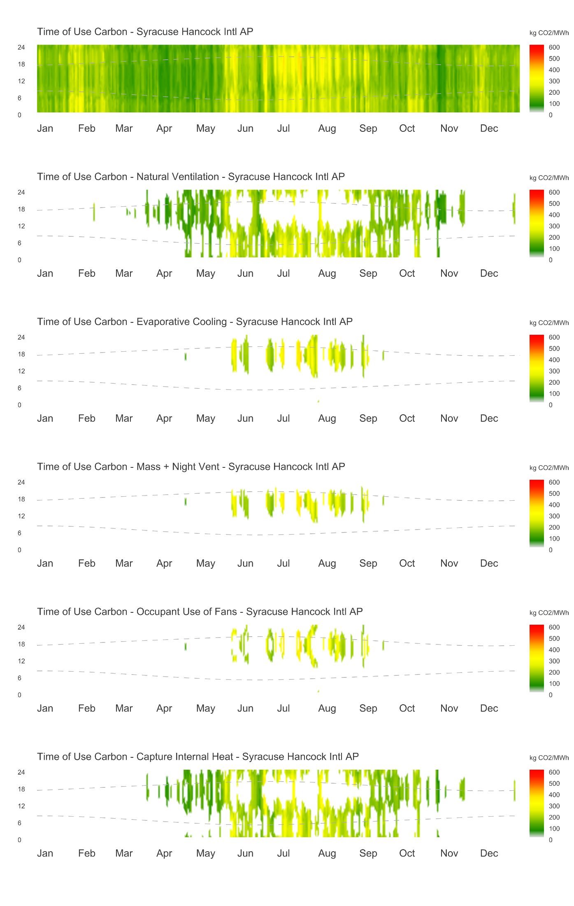
Climate Analysis
REGIONAL INFLUENCES
Sky Conditions
Partly cloudy and overcast conditions dominate the climate. Overhead shading can play an important role in June/July when skies are clearer, and prevention of overheating is important
Decent solar production capability
Local Electricity Grid
Electrical grid is substantially less CO₂e intensive than the national average. primarily due to its substantial reliance on nuclear energy and a growing commitment to renewable sources.
Passive strategies that have greatest impact on higher emissions hours are evaporative cooling, mass + night ventilation, occupant use of fans
Carbon Emission Factors
US Average (Electricity) | kg CO₂e/kBtu
Local Grid (Electricity) | kg CO₂e/kBtu
Natural Gas | kg CO₂e/kBtu

Slide 4
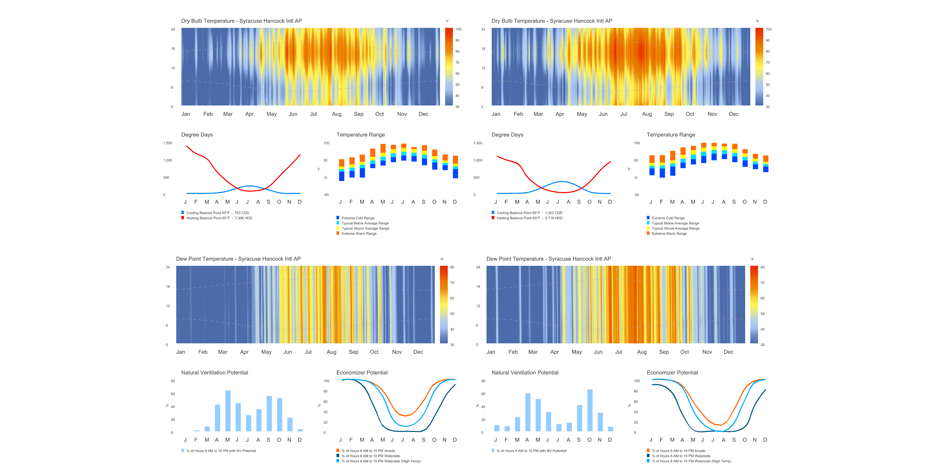
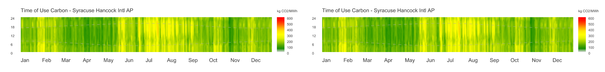
Climate Analysis
YEAR 2025 VS 2050 (RCP 4.5 Scenario)
Temperature Increases
Rising Average Temperatures and Humidity : Newyork is expected to experience a rise in average temperatures and humidity. Emphasizing the importance of shade to shave peak cooling loads.
Increase in Extremely Hot Days: an average of 38 days will exceed a temperature of 92.7 °F by 2050. Design for indoor comfort using passive cooling, reflective roofing, wall insulation to block heat gain. Mitigate urban heat island effect increasing usability of outdoor spaces
Local Electricity Grid
The planned retirement of aging nuclear facilities across the broader Northeast and Midwest US — including potential future decommissioning of upstate New York's own nuclear assets as they approach end-of-life — poses a meaningful risk to both grid reliability and carbon performance. Proactive measures, including the expansion of renewable energy and energy storage, are essential to mitigate these potential impacts.

Slide 5
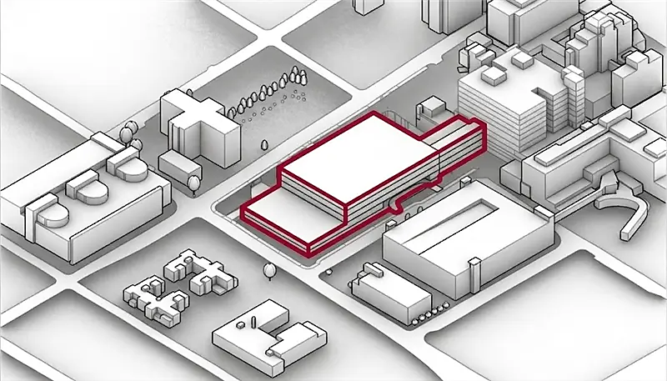
Project Utility Profile
Utility
Source
Electricity
Resource Provider - Niagara Mohawk
Natural Gas
Resource Provider - National Grid
Water
Resource Provider - Syracuse Water Dept.
Sewer
Onondaga County
Department of Water Environment Protection (WEP)
Notes:
https://www.nlr.gov/analysis/cambium
Cambium | Energy Systems Analysis | NLR

Slide 6
Project Utility Profile
0.13
0.18
0.19
0.11
kWh
0.22
kWh
Utility Rate
Electricity
0.36
kBtu
0.75
kBtu
Values in kBtu
1.21
Utility Rate
Natural Gas
1
$/therm
1.55
$/therm
Values in $/kBtu
0.010
$/kBtu
0.015
$/kBtu
1.27
1.40
Grid
Carbon Emissions
0.01
kgCO2e/kWh
0.51
kgCO2e/kWh
Legend
US State Lowest Value
US State Average Value
US State Highest Value
State Average Value: Newyork
Local Value: Syracuse
Natural Gas Carbon Emissions
0.003
kgCO2e/kBtu
0.820
kgCO2e/kBtu
Values in kgCO2e/kBtu
0.015
0.21
0.21
0.39
Source:
Electricity Utility Rates: OpenEI Utility Rate Database (IURDB), U.S. Department of Energy (2026)
Natural Gas Utility Rates : Opendata - U.S. Energy Information Administration (EIA)
Grid Carbon Emissions: NREL – Government website
Notes:
Add units on both end or mention what are the units. Add values on slide 3

Slide 7
Project Utility Profile
3.50
5.50
6.50
Utility Rate -
Water Service
2.50
$/kGal
11.00
$/kGal
6.50
Utility Rate -
Sewer
3.00
$/kGal
14.00
$/kGal
3.50
7.50
4.50
Utility Rate -
Irrigation
Legend
US State Lowest Value
US State Average Value
US State Highest Value
State Average Value: Newyork
Local Value: Syracuse
1.50
$/kGal
10.00
$/kGal
3.00
5.00
Source:
Water Utility Rates: Circle of Blue \u2013 Water Pricing (2026)
Sewer & Irrigation Rates: Estimated from municipal utility rate surveys
Notes:
Add units on both end or mention what are the units. Add values on slide 3

Slide 8
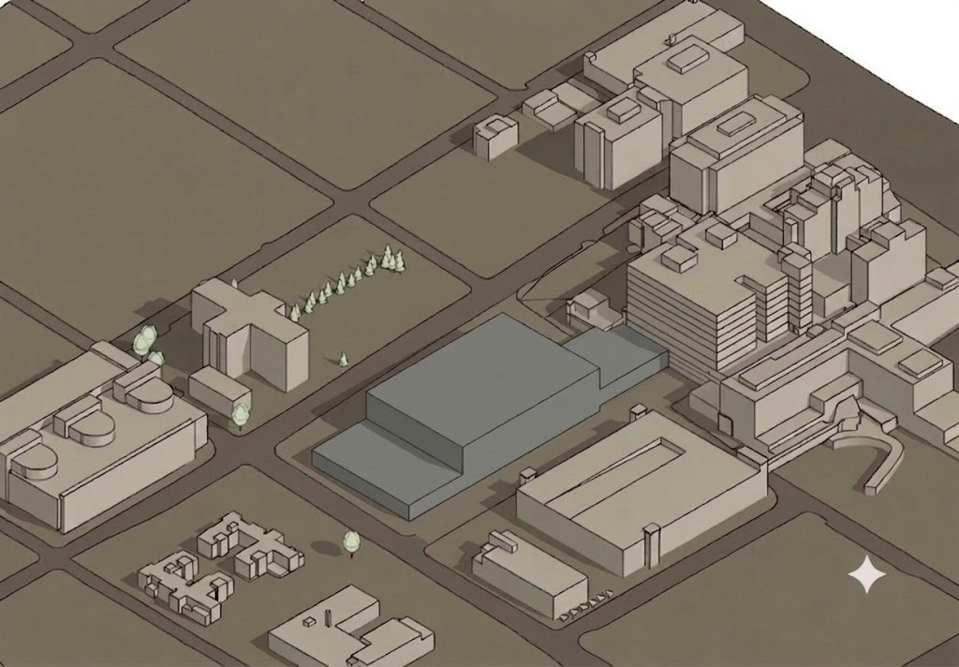



Project Renewable Energy Profile
40% of Proposed Building Roof
10.57 kBtu/sq.ft
Solar Radiation
kWh/m²
1500
1250
Canopy Above Green Roof
0.72 kBtu/sq.ft
1000
750
40% of East Garage Roof
11.61 kBtu/sq.ft
500
250
0
Notes:
Combine graphic and text into 1 graphic
C:\Users\upawar\CannonDesign\Mumbai Office - Mumbai Sustainability\11_SUNY\Project Files\Reference\Images

Slide 9
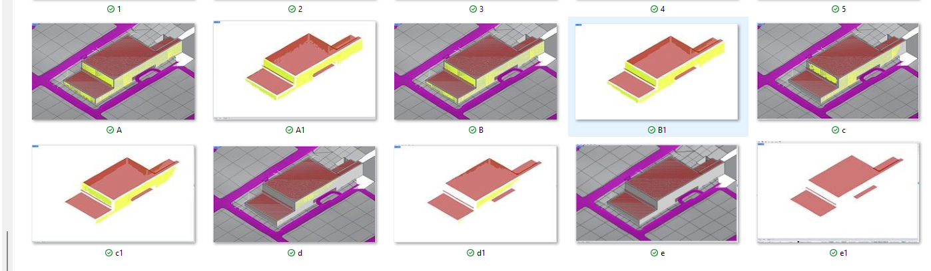
Project Renewable Energy Profile
Photoshop this
A=0
B=250
c-=500
D=750
E=1250/1500

Slide 10
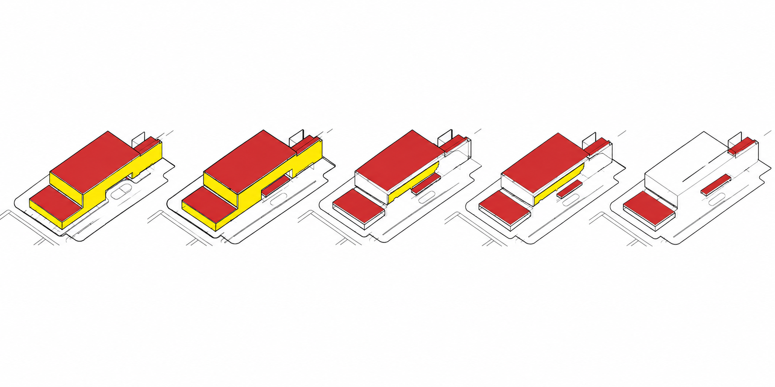
Project Renewable Energy Profile
Beyond 700 kWh/m², a higher Lower Limit yields negligible additional EUI offset.

Slide 11
Project Renewable Energy Profile
Beyond 700 kWh/m², a higher Lower Limit yields negligible additional EUI offset.

Slide 12
Lower Limit (kWh/m2) | BIPV Module Area (ft2) | BIPV DC Capacity (kW) | BIPV Productional Potential kWh | BIPV Productional Potential (kWh/Area) | EUI Offset kBtu/sq.ft
0 | 43,676 | 324.6 | 149,671 | 3.4 | 2.27
100 | 37,081 | 275.6 | 148,841 | 4.0 | 2.26
200 | 36,277 | 269.5 | 148,160 | 4.1 | 2.25
300 | 35,855 | 266.4 | 147,456 | 4.1 | 2.24
400 | 32,649 | 242.5 | 140,214 | 4.3 | 2.13
500 | 30,014 | 222.9 | 132,526 | 4.4 | 2.01
600 | 23,766 | 176.4 | 111,033 | 4.7 | 1.68
700 | 17,407 | 129.1 | 84,723 | 4.9 | 1.28
800 | 3,824 | 28.2 | 20,179 | 5.3 | 0.3
900 | 440 | 2.9 | 2,360 | 5.4 | 0.03
1000 | 79 | 0.2 | 201 | 2.5 | 0.003
1100 | 52 | 0.0 | 0 | 0.0 | 0
1200 | 52 | 0.0 | 0 | 0.0 | 0
1300 | 52 | 0.0 | 0 | 0.0 | 0
1400 | 52 | 0.0 | 0 | 0.0 | 0
1500 | 52 | 0.0 | 0 | 0.0 | 0

Slide 13
Project Renewable Energy Profile
All charts — X-axis: Lower Limit (kWh/m²)

Slide 14
Project Renewable Energy Profile
Beyond 700 kWh/m², a higher Lower Limit yields negligible additional EUI offset.

Slide 15
EUI Offset vs. Production Intensity (kWh/Area)

Slide 16
LCOE Methodology
LCOE Parameters.
Total cost of solar array
How much energy it would produce in 25 years
Life cycle analysis period because panels are warranted for 25 years : 25 years
We take the analysis period into account because we want to do degradation through the years
Total cost for the PV / Total electricity generated give cost in terms of cents / kWh

